Slide 1
Learning Frameworks for Various Airfoils
Group 7:
Gabriel Achour, Yash Hemant Chitale, Yoobin Kim, Aqib Ahmed Syed

Slide 2
Motivation
Aerodynamic shape optimization is a mandatory process in designing parts like aircraft wings and (propeller, turbine, rotor) blades [1] Each aerodynamic shape produces different performances.
Need to assess the performances given the shape in order to optimize
No unique association between functional requirements and geometric shape [2]
Cost of the Computational Fluid Dynamics (CFD) simulator can be an obstacle [2]
Credits: Encyclopedia of Engineering
The focus of this work is on airfoils (aircraft wing profile) and finding other ways less computationally expensive to assess their aerodynamic performances

Slide 3
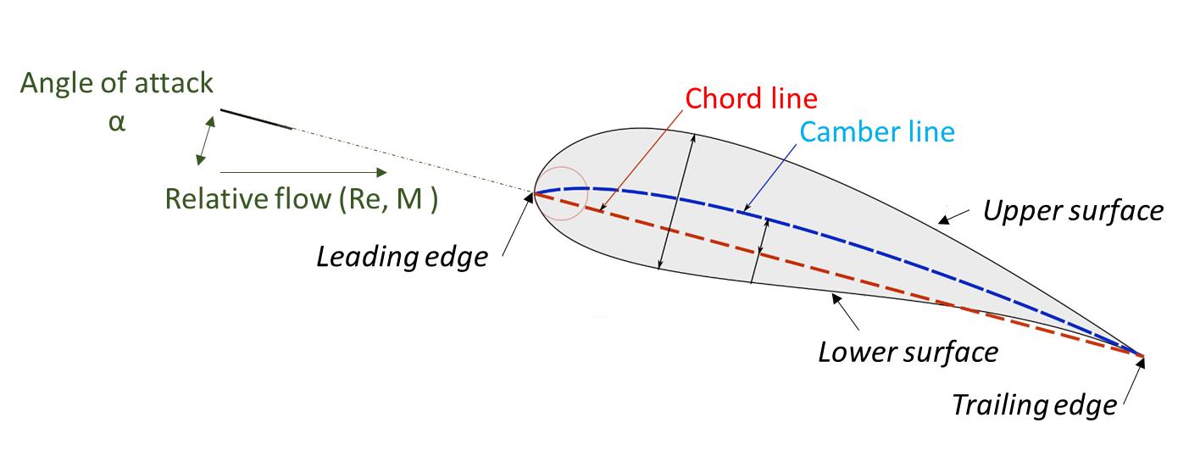
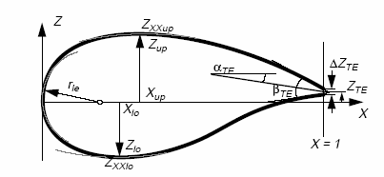
Airfoils
PARSEC Parameters
Credits: Ava Shahrokhi
Given flow parameters: Re, M∞, 𝛼 and Airfoil Shape
Assess
Aerodynamic requirements:
c_{l} , c_{d}, l/d
Structural requirements:
Area

Slide 4
Objective and method
Objective: Use a machine learning framework to provide an estimate of the aerodynamic performances for any airfoil
Collect a dataset and perform data pre-processing
Implement a clustering algorithm to identify relevant clusters in the data and create classes to predict
Implement a classification framework to predict to what class (created in step 2) does any airfoil belong to

Slide 5
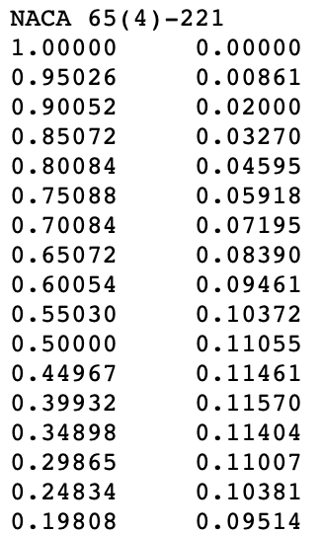
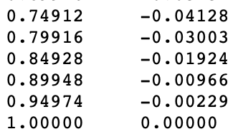
Dataset
Name of the airfoil
There are different free databases storing the coordinates of different airfoils such as the
UIUC Airfoil Coordinate Database containing about 1500 different airfoils in .dat format
X coordinates
Y coordinates
[…]
Credits: NASA History

Slide 6
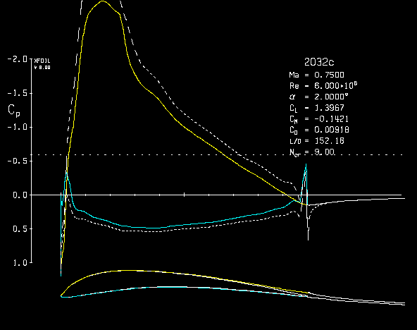
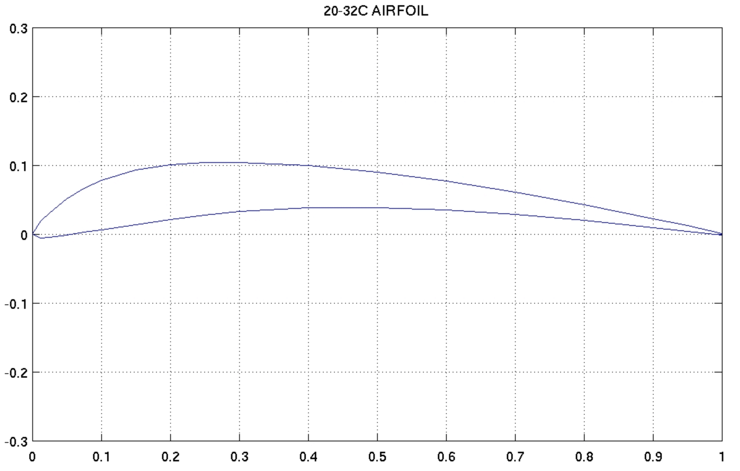
Data-Preprocessing
Extract Cl, Cd using a flow simulator (Xfoil)
Extract PARSEC parameters
Credits: Ava Shahrokhi

Slide 7
Step 1: Clustering
Cd
1
2
Example: 4 categories
Cl < Cl_1 and Cd > Cd_1 [1, 0, 0, 0]
Cl > Cl_1 and Cd > Cd_1 [0, 1, 0, 0]
Cl < Cl_2 and Cd < Cd_1 [0, 0, 1, 0]
Cl > Cl_2 and Cd < Cd_1 [0, 0, 0, 1]
3
4
Objective: Identify relevant classes that splits the dataset in order to create the categories for step 2
Cl

Slide 8
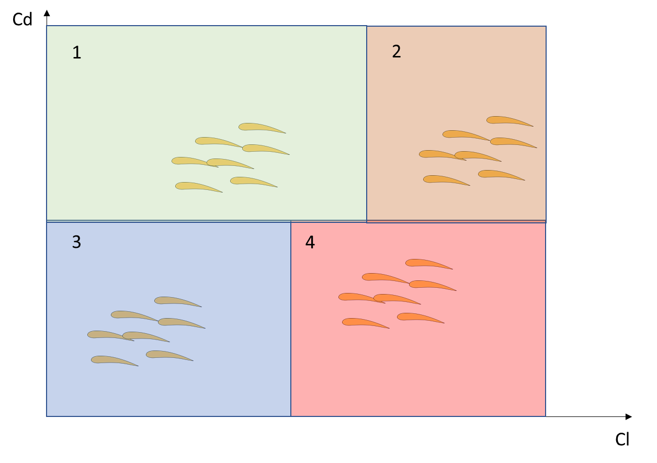
Step 2: Classification
PARSEC Parameters
Multi-Layer Perceptron
Credits: Ava Shahrokhi
Objective: train a classifier (e.g. MLP) that takes the parsec parameters as an input and outputs the airfoil class

Slide 9
Expected contributions
This project will demonstrate the implementation of a clustering and classifier framework applied to the field of aerodynamic shape
Provide a fast-computing method that provides an estimate of the aerodynamic performances given any airfoil shape

Slide 10
References
Chen W., Chiu K., Fuge M., Aerodynamic Design Optimization and Shape Exploration using Generative Adversarial Networks, University of Maryland, College Park, Maryland, 20742
L. DI Angelo, P. Di Stefano, “An evolutionary geometric primitive for automatic design synthesis of functional shapes: The case of airfoils”

